Slide 1
CAR PRICE PREDICTION PROJECT

Slide 2
Abstract
A car price prediction has been a high interest research area, as it requires noticeable effort and knowledge of the field expert. Considerable number of distinct attributes are examined for the reliable and accurate prediction.
To build a model for predicting the price of used cars the applied three machine learning techniques are Artificial Neural Network and linear regression.
Respective performances of different algorithms were then compared to find one that best suits the available data set. The final prediction model was integrated into Java application. Furthermore, the model was evaluated using test data and the accuracy of 84% was obtained

Slide 3
Introduction
Vehicle price prediction especially when the vehicle is used and not coming direct from the factory, is both a critical and important task. With increase in demand for used cars more and more vehicle buyers are finding alternatives of buying new cars.
There is a need of accurate price prediction mechanism for the used cars. Prediction techniques of machine learning can be helpful in this regard.
It is common to lease a car in many countries rather then buying a new car

Slide 4
EDA Concluding Remarks
.Find patterns of data through visualization and reveal the hidden trends from data.
Using both matplotlib and seaborn library to visualize the data
Finding relationships between features using bar graphs, histograms, box plots, heatmap
Analyzing both the numerical and the categorical columns separately

Slide 5
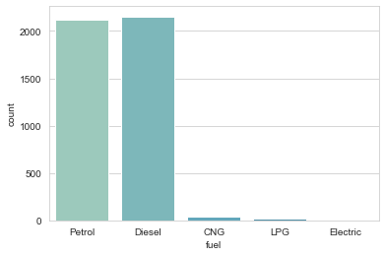
sns.countplot(df['fuel’]) Here data is not normally distributed in all columns

Slide 6
Data Visualization
Data visualization is the graphical representation of information and data. By
using visual elements like charts, graphs, and maps, data visualization tools provide an
accessible way to see and understand trends, outliers, and patterns in data. In the
world of Big Data, data visualization tools and technologies are essential to analyze
massive amounts of information and make data-driven decisions.

Slide 7
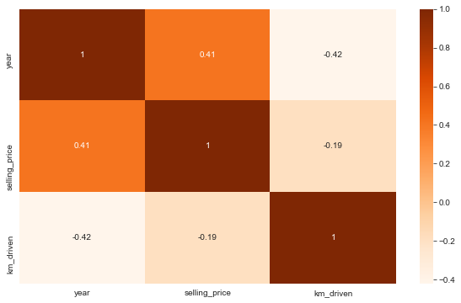
plt.figure(figsize=(10,6)) sns.heatmap(dfcor,cmap='Oranges',annot=True)

Slide 8
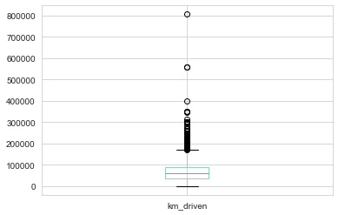
df["km_driven"].plot.box() Here boxplot have outside the viscous so we can find here outliers easily.

Slide 9
Pre-processing pipeline:
For the model to proceed with the data efficiently, the categorical variables
salary and department have been encoded. As the values of salary have an order, they have been encoded
into integers within the same variable. For department, as the values have no specific order, they have been
encoded into individual variables with Boolean values. Thus, the dataset has been transformed from 10variables to 19 variables. Numerical variables scaled between 0 and 1 to remove any influence of their difference in value ranges on the model. They have also been checked for skewness, without a real change on their shape.

Slide 10
Building machine learning model:
As the dataset is imbalance, use cross validation when training the models, and each baseline model performance can be tabulated.
The model will be cross-validated using a 10-fold cross validation method returning the average accuracy. This method will be applied at every modelling step, to ensure that the model is not biased by the training set split

Slide 11
According to the Regression report the accuracy of the model is 84% however positive cases. The RandomForestRegressor is providing excellent results, however the purpose of the problem is to identify employees that are likely to leave. This is the reason that recall then becomes a very important measure.
Recall measures the fraction of values that are identified correctly. Random Forest Regression has emerged as the final
winning model with 84% and highest 84%. This could be the highest possible score achieved with the inherent limitations in the dataset

Slide 12
Machine learning models are as good as the data to feed it, and more data would strengthen the model. For example, in this dataset, the feature ‘Performance Rating’ has been restricted to scores of 3 and 4 only. More insights could be generated if the full spectrum of performance ratings is included. In the real-life situation, getting the right data is often more challenging than the analytics itself.

Slide 13
A Random Forest is an ensemble technique capable of performing both regression and
classification tasks with the use of multiple decision trees and a technique
called Bootstrap Aggregation, commonly known as bagging
Bagging, in the Random Forest method, involves training each decision tree on a
different data sample where sampling is done with replacement.
The basic idea behind this is to combine multiple decision trees in determining the
final output rather than relying on individual Random forest regressor

Slide 14
CONCLUSION
The type of recommendation engine built in this study is called content-based filtering because it uses only intrinsic and spatial features engineered for prediction. This type of recommendation needs a training set that would be too large to generate manually.
In practice, another type of recommendation engine—community-based filtering—is employed. It uses the features engineered for the properties, combined with favorite and blacklist data, to find similarity between a large number of buyers. It then pools the training set from similar buyers to create a large training set.

